Slide 1
Introductory Data Science
Workshop by - Suraj Awal

Slide 2
What do you think?
The first question:
What is data science and what is its necessity?

Slide 3


1. Data Science
The world has tons of data.
Data Science is all about playing with data employing scientific methods and processes to get valuable insights from the data.
Unexpected Highlight what’s new, unusual, or surprising.
Emotional Give people a reason to care.
Simple Provide a simple unifying message for what is to come

Slide 4
What do you need?
Programming (Python and R)
Probability and Statistics
Basic Mathematics
Critical Thinking and Analysis

Slide 5

Critical Thinking in Data Science
Tip
Never think what others think….
If you think what others think, you will never be unique.

Slide 6

Critical Thinking in Data Science

Slide 7
Data Scientist……..
The Sexiest Job of 21st Century.
Article on Harvard Business Review

Slide 8
Machine Learning
What Study and design of software system that learns from past experiences to make future decisions.
Types - Supervised Learning (Regression and
Classification Problem)
- Unsupervised Learning

Slide 9
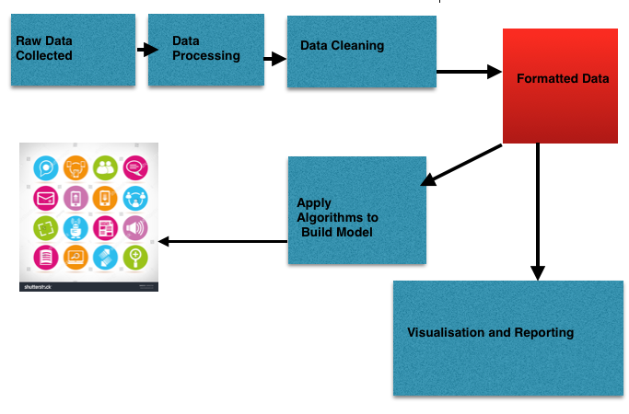

Slide 10

Organized By:
Newa Bidhyarthi Dabu,
Purwanchal Campus Committee
Supported By:
Surajawal.pythonanywhere.com Opaline Technologies Pvt. Ltd.

